Slide 1
End-to-End Sales & Customer Intelligence Analysis for Revenue Optimization

Slide 2
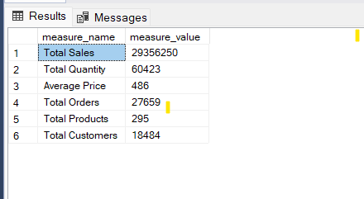
1. Project Overview
In this project, I performed end-to-end sales and customer analysis using SQL. I worked with 18K+ customers, 295 products, and transactional data to extract business insights and support decision-making.

Slide 3
2. Business Performance
The business generated 29.35M in revenue from 27K+ orders. However, when we divide revenue by customers, we see low revenue per customer, which indicates a volume-based business rather than a high-value one.
Insight:
Growth is present
But customer value is low
Conclusion: We should focus on increasing revenue per customer.

Slide 4
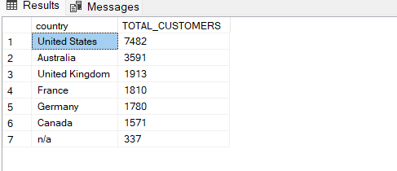
3. Customer Insights
The majority of customers (~40%) come from the United States, while other countries like Canada and Germany contribute significantly less.
Insight:
Business is heavily dependent on one market
Decision: We should expand globally to reduce risk and increase revenue opportunities.

Slide 5
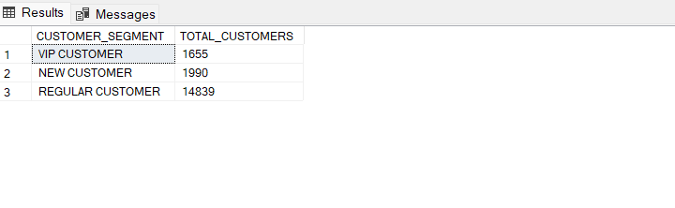
4. Customer Behavior
Most customers are regular users, but only a small percentage are VIP customers. Also, many customers made only one purchase.
Insight:
Low retention
Weak customer loyalty
Decision: We need loyalty programs and retention strategies to convert regular users into repeat and VIP customers.

Slide 6
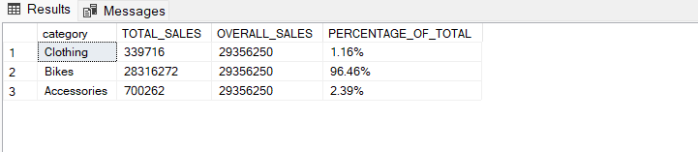
5. Product Analysis
Even though we have multiple categories, Bikes alone generate 96% of total revenue, while accessories and clothing contribute very little.
Insight:
Extreme dependency on one category
Risk: If bike sales drop, overall revenue will collapse.
Decision: We must diversify product categories.

Slide 7
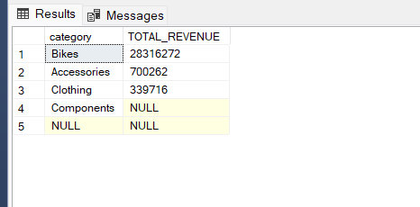
6. Pricing Strategy
Bikes are high-ticket items, while other products are low-cost add-ons.
Insight:
Bikes = revenue drivers
Accessories = support products
Decision: Use accessories for cross-selling and bundling strategies.

Slide 8
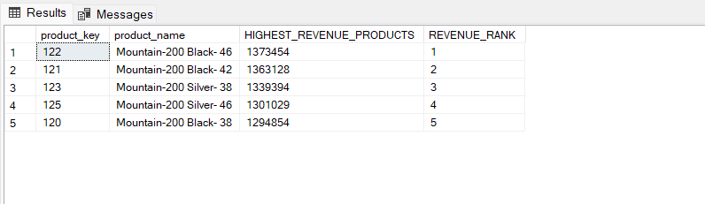
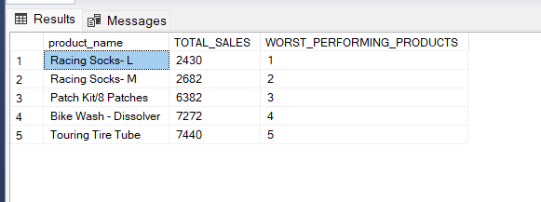
7. Product Performance
Top-performing products are all mountain bikes, while low-performing products include socks and small accessories.
Insight:
Few products generate most revenue.
Decision:
Focus on top products and bundle or remove weak products.

Slide 9
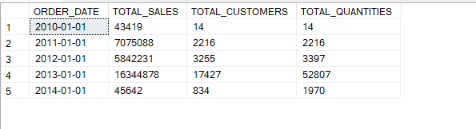
8. Sales Trends
Sales saw a major spike in 2013, followed by fluctuations.
Insight:
Growth is not consistent
Decision:
We need stable revenue strategies like seasonal campaigns and retention.

Slide 10
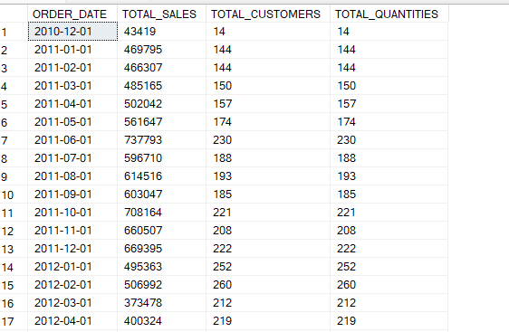
9. Monthly Trends
Sales vary across months, indicating possible seasonality.
Decision: Run targeted campaigns during peak seasons.

Slide 11
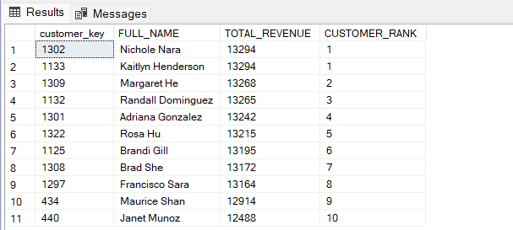
10. Customer Revenue Contribution
Top customers generate around 13K revenue, but there are no extremely high-value customers.
Insight:
No strong VIP base
Decision:
Create VIP tiers and reward high-value customers.

Slide 12
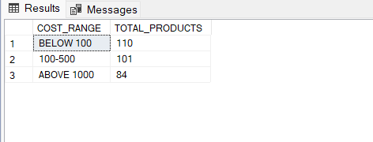
11. Product Segmentation
Most products fall under mid-range pricing.
Insight:
No strong premium or budget strategy.
Decision:
Introduce premium and low-cost product tiers.

Slide 13

12. Key Problems
The business faces 4 major issues
Overdependence on bikes
Low customer retention
Weak product diversification
Heavy reliance on US market”

Slide 14
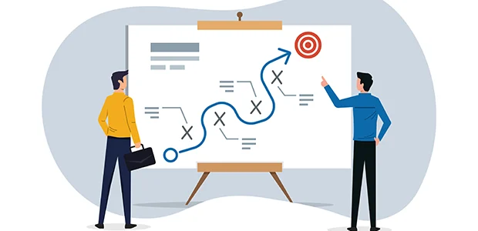
13. strategic Recommendations
1. Increase Revenue per Customer → Implement upselling & product bundling → Boost Average Order Value (AOV)
2. Improve Customer Retention → Introduce loyalty programs & personalized offers → Convert one-time buyers into repeat customers
3. Diversify Revenue Streams → Strengthen accessories & clothing categories → Reduce dependency on Bikes (currently ~96%)
4. Expand Global Presence → Target underperforming regions (Europe, others) → Reduce over-reliance on US market
5. Optimize Product Strategy (80/20 Rule) → Focus on top-performing products → Bundle or eliminate low-performing items

Slide 15
14. Final Conclusion
This analysis shows how data can be used not just for reporting, but for strategic decision-making.
By focusing on customer value, diversification, and retention, the business can achieve sustainable growth.

